Slide 1


Slide 2
Data Tells a Story

Slide 3
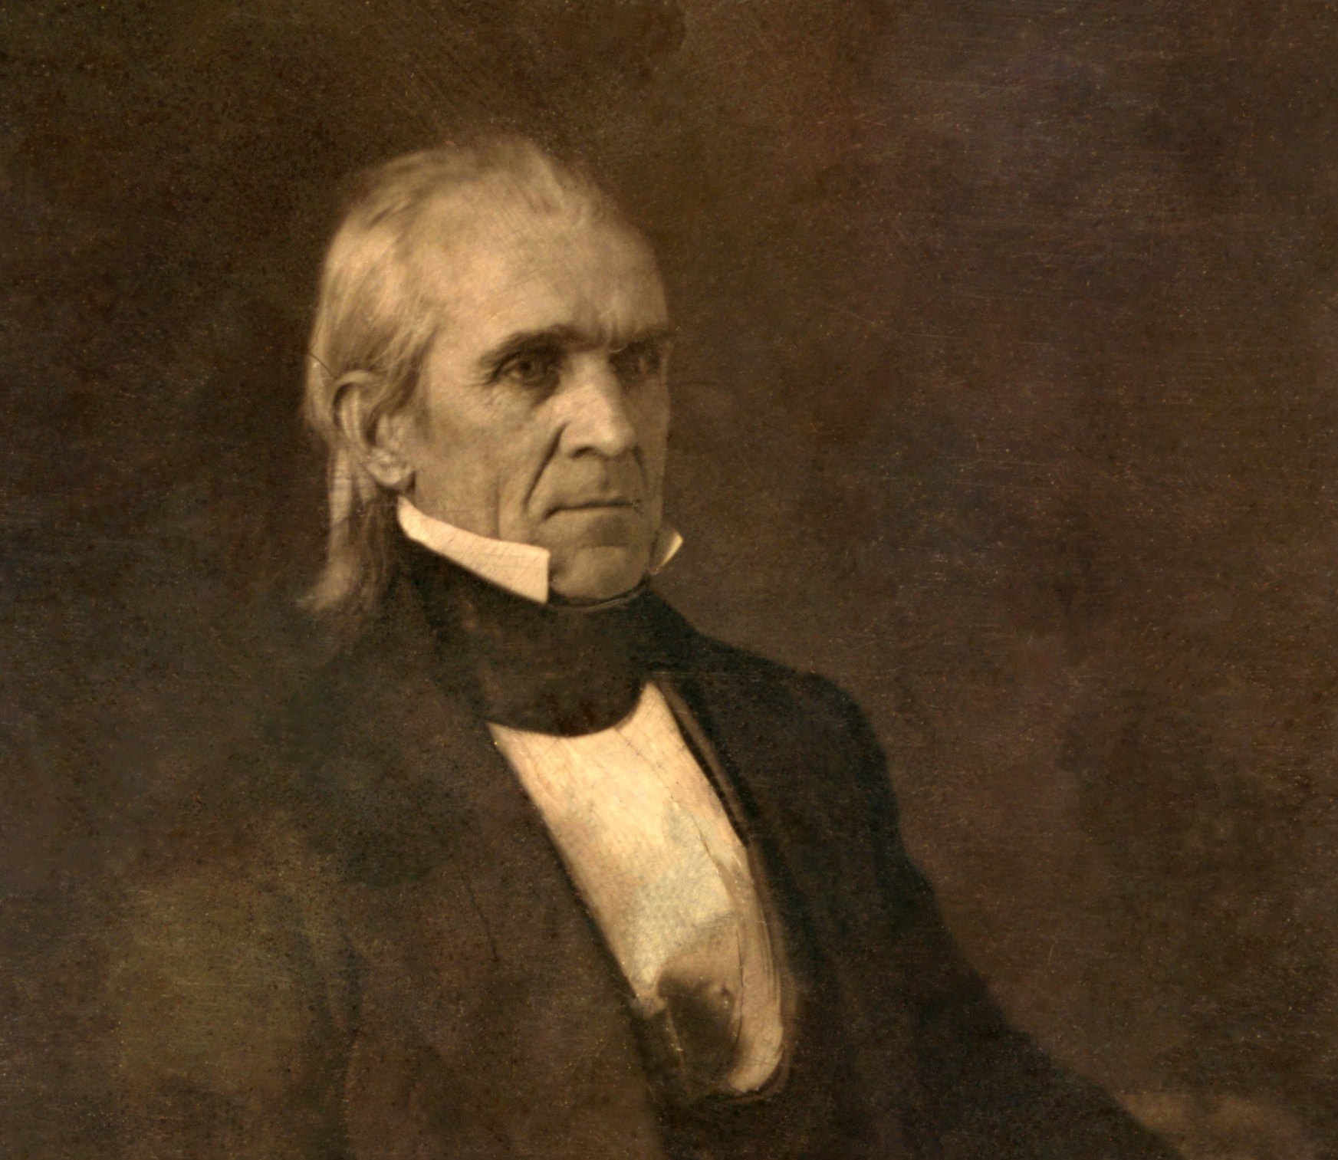
Famous Residents

Slide 4
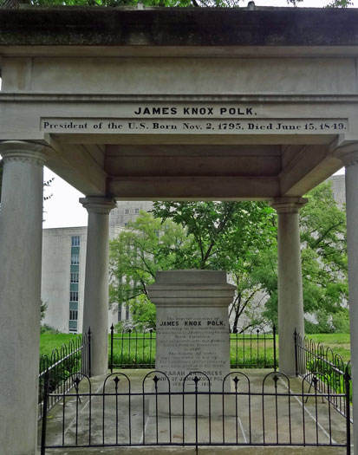
James K. Polk
11th President of the U.S.A.
Buried NCC in 1849.
Likely died of Cholera.
Moved to Polk estate in 1850.
Moved once again to current resting place in 1893.

Slide 5

Community Engagement
QR codes:
Simple
Cost effective
Accessible
Informative

Slide 6
Thank you!

